Slide 1

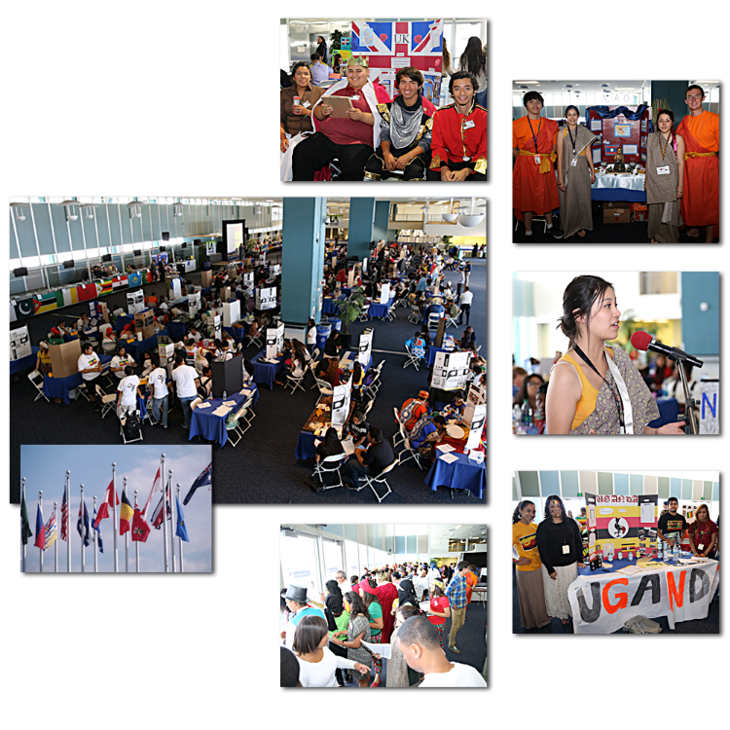
Port of
Los Angeles
International Economic Summit
Special Event

